Slide 1

Dr. Sajid Iqbal
Department of Computer Science
Bahauddin Zakariya University, Multan

Slide 2

INTRODUCTION TO Machine Learning 3rd Edition
ETHEM ALPAYDIN
© The MIT Press, 2014
alpaydin@boun.edu.tr
http://www.cmpe.boun.edu.tr/~ethem/i2ml3e

Slide 3
Multivariate Methods
Chapter Five

Slide 4
5.1 Introduction

Slide 5


Introduction
In this chapter, we discuss classification and regression which involve more than 2 variables
A dataset consisting of d-features and N samples can be represented as $X={\left\{x^{t}\right\}}_{1}^{N}$
There are d features/ inputs/ attributes in our data
There are N independent examples/ events/ observations/ instances
The features may be numeric or nominal and on different scale
Usually these variables/features are correlated
If they are not co-related, there is no need data analysis
Classification: If predicted value is discrete
Regression: if predicted value is a real number
$$\left[\begin{matrix}X_{1}^{1} & ⋯ & X_{d}^{1} \\ ⋮ & ⋱ & ⋮ \\ X_{1}^{N} & ⋯ & X_{d}^{N}\end{matrix}\right]$$

Slide 6

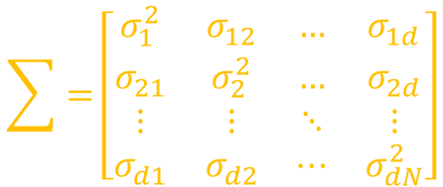

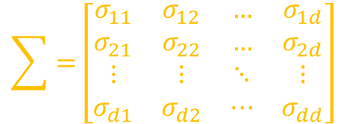
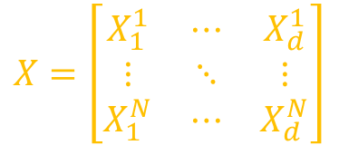
Parametric Estimation
Mean Vector: It is the mean of each column/feature
Where $μ_{i}$ represents the mean of $i^{th}$ column
Variance of $X_{i}$ is denoted as $σ_{i}^{2}$
Covariance of $X_{i}$ and $X_{j}$ is given as
Covariance Matrix: for d variables there are
$d$-variances (diagonal terms)
$\frac{d\left(d−1\right)}{2}$covariances (off-diagonal terms)
$$E\left[x\right]={\left[μ_{1},μ_{2},…,μ_{d}\right]}^{T}$$
$$X=\left[\begin{matrix}X_{1}^{1} & ⋯ & X_{d}^{1} \\ ⋮ & ⋱ & ⋮ \\ X_{1}^{N} & ⋯ & X_{d}^{N}\end{matrix}\right]$$
$$σ_{ij}= Cov(X_{i}, X_{j}) = E[(X_{i} − μ_{i})(X_{j} − μ_{j})] = E[X_{i}X_{j}] − μ_{i}μ_{j}$$
$$\sum{=}\left[\begin{matrix}σ_{11} & σ_{12} & … & σ_{1d} \\ σ_{21} & σ_{22} & … & σ_{2d} \\ ⋮ & ⋮ & ⋱ & ⋮ \\ σ_{d1} & σ_{d2} & ⋯ & σ_{dd}\end{matrix}\right]$$
$$\sum{=}\left[\begin{matrix}σ_{1}^{2} & σ_{12} & … & σ_{1d} \\ σ_{21} & σ_{2}^{2} & … & σ_{2d} \\ ⋮ & ⋮ & ⋱ & ⋮ \\ σ_{d1} & σ_{d2} & ⋯ & σ_{dN}^{2}\end{matrix}\right]$$
$$\sum{=} Cov(X) = E[\left(X−μ\right){\left(X−μ\right)}^{T}]=E[XX^{T}] − μμ^{T}$$

Slide 7
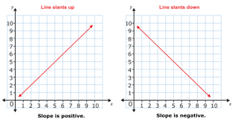


If two $(x,y)$ variables are related in linear way
The relationship will be positive if the slope is positive $x/y$
The relationship will be negative if the slope is negative $x/y$
The size of relationship is difficult to interpret due to varying units of variable measurement i.e. age and income
Correlation
It is statistic normalized between -1 and +1
For two independent variables, correlation and covariance will be zero
Converse is not true
$$Cor\left(X_{i},X_{j}\right)=ρ_{ij}=\frac{σ_{ij}}{σ_{i}σ_{j}}$$

Slide 8
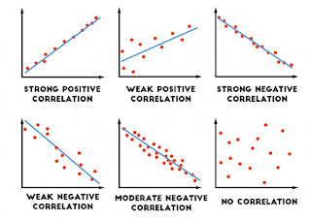
Correlation

Slide 9
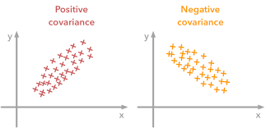
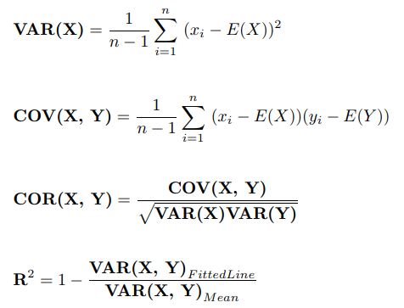

The MLE estimate for $μ$ is $m$ where
$m=\sum_{t=1}^{N}{\frac{x^{t}}{N}}$ and $m_{i}=\sum_{t=1}^{N}{\frac{x_{i}^{t}}{N}}$ for $i=1,2,3,….,d$ (d variables or features)
Sample Covariance (S) is estimator for population covariance $(\sum{).}$
It is covariance of sample and is estimator for
$s_{i}^{2}=\sum_{t=1}^{N}{\frac{{\left(x_{i}^{t}−m_{i}\right)}^{2}}{N}}$ and $s_{ij}=\frac{\sum_{t=1}^{N}{(x_{i}^{t}−m_{i})}(x_{j}^{t}−m_{j})}{N}$
Sample Correlation Coefficients
$r_{ij}=\frac{s_{ij}}{s_{i}s_{j}}$

Slide 10
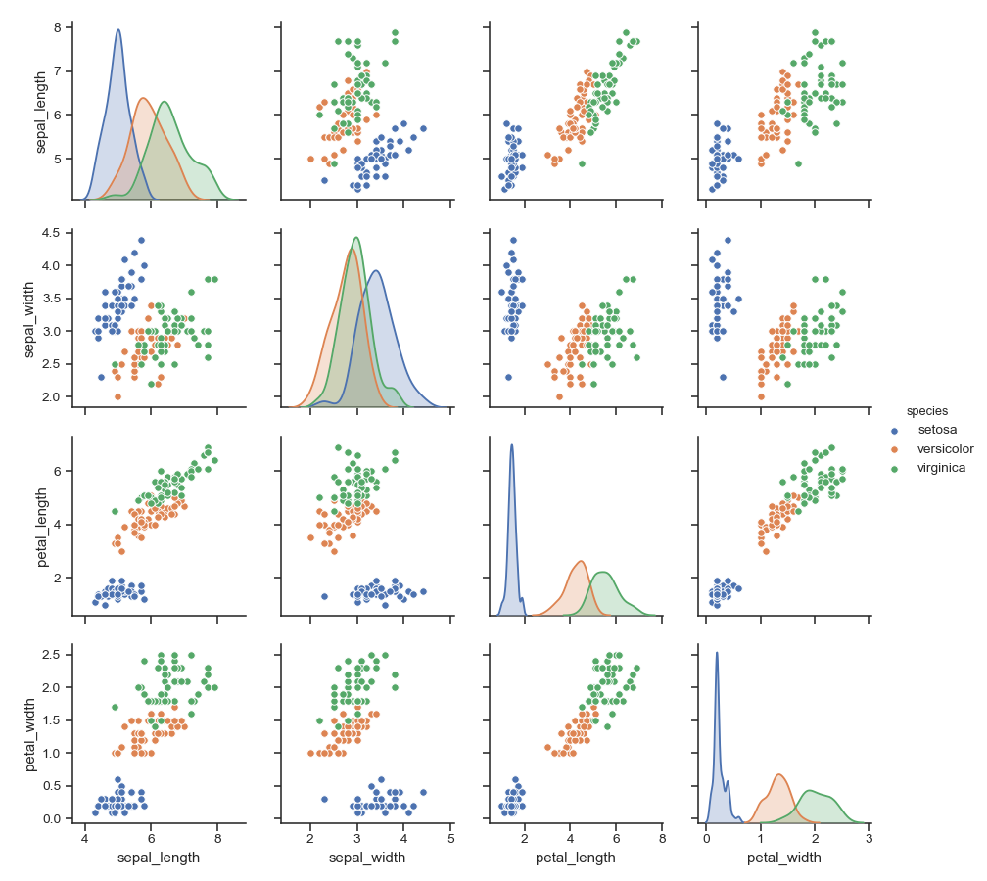

Slide 11
Exercise
Use the flower dataset
Find its
Covariance, correlation
Get a sample from the dataset and
Find covariance and correlations

Slide 12
Estimation of Missing Values

Slide 13
Imputation
A dataset may contain missing values for different features
Discard the records with missing values. But we cant due to
Small dataset size: discarding such records will reduce the dataset size
There is some information present in such records that we cant miss
Imputation: Fill the missing values by estimating them
Mean imputation
for numeric values, replace missing value with mean value
For categoric data, replace missing value with most likely data i.e. most frequent value
Regression imputation
Use regression to find the missing values for given case
However all type of values can not be imputed i.e. CNIC

Slide 14
Multivariate Normal Distribution

Slide 15



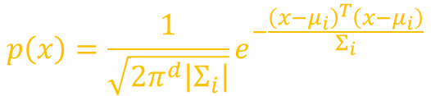

Single variate and multivariate normal distribution
Single variate linear model: $y=w_{1}x_{1}+w_{0}$
Multivariate linear model: $y=w_{n}x_{n}+w_{n−1}x_{n−1}+…+w_{1}x_{1}+w_{0}$
Single variate normal distribution:
And short hand notation of uni-variate normal distribution is give as
Multivariate normal distribution
And in short it could be written as
$$p\left(x\right)=1/(\sqrt{2πσ^{2}} e^{− \frac{x−μ}{σ^{2}}})$$
$$X\sim N(μ,σ^{2})$$
$$p\left(x\right)=\frac{1}{\sqrt{2π^{d}\left|Σ_{i}\right|}}e^{−\frac{{\left(x−μ_{i}\right)}^{T}\left(x−μ_{i}\right)}{Σ_{i}}}$$
$$X\sim N_{d}(μ_{i},Σ_{i})$$

Slide 16
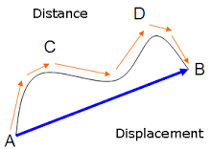
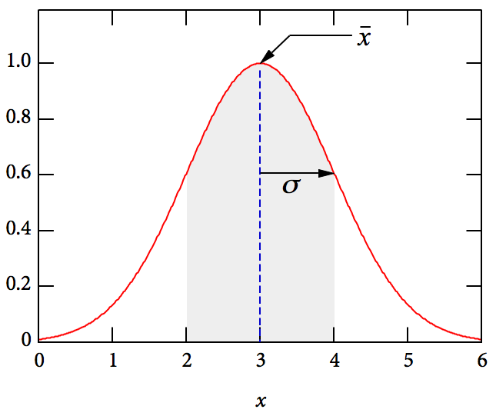

The Distance for univariate data
It is the distance of a point from some reference point
For a univariate data, the distance can be measured in terms of standard deviation
Univariate data could be given as $y=ax+b=w_{1}x_{1}+w_{0}$
Such distance can also give information about distribution
For normal distribution, there is more change to observe a value at one standard deviation distance than 2 standard deviation
For normal distribution such a score can be calculated in terms of z-score (distance of a point from mean)
$z=\frac{x−μ}{σ}$

Slide 17
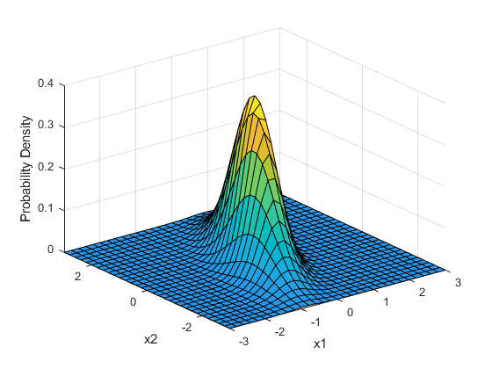
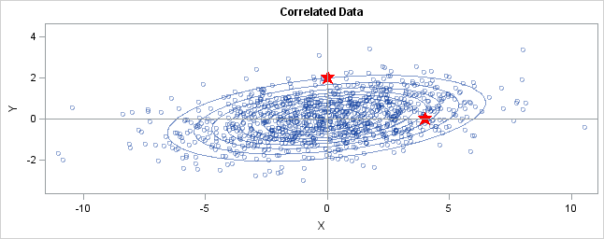

The Distance for Multivariate Data
Multivariate linear distribution can be given as (in general form)
$y=w_{n}x_{n}+w_{n−1}x_{n−1}+…+w_{1}x_{1}+w_{0}x_{0}$
A bivariate linear distribution can be given as
$y=w_{2}x_{2}+w_{1}x_{1}+w_{0}$
The probability density is high for inner contours
Two points in red are shown top and right (4,0),(0,2)
Q: Which point is closer to origin
A: Depends how you measure distance

Slide 18
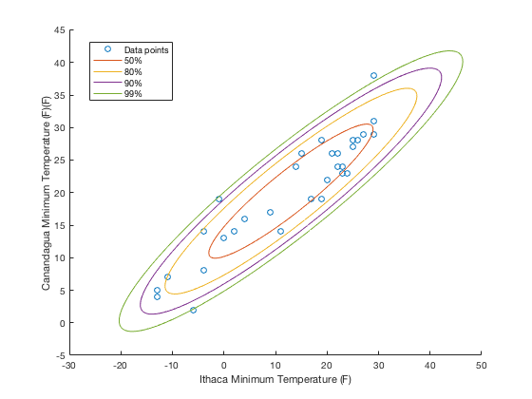
The Distance
Euclidian Distance: 4,2
Hence point (0,2) is closer
In SD units
Along y-axis, variance is small and distance is 4 SDs
Along x-axis the variance is more and it is 1 SDs
So point (4,0) is closer
The ellipses are known as probability contours

Slide 19

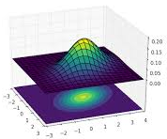
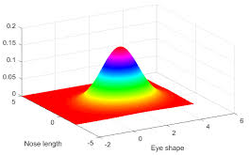
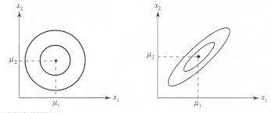
Mahalanobis Distance
Probability contours can be used to define the Mahalanobis distance
It accounts for the fact that the variances in each direction are different
It accounts for the covariance between variables
It reduces to the familiar Euclidean distance for uncorrelated variables with unit variance

Slide 20
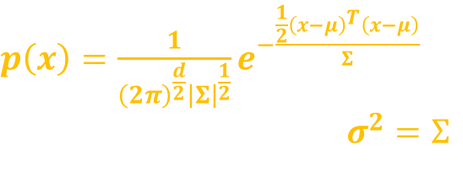

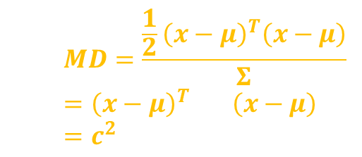
Mahalanobis Distance (MD)
The dataset X is d-dimensional and normally distributed
If $x ∼ N_{d}(μ, Σ)$with $μ$ as mean vector and $Σ$ as covariance matrix
Mahalanobis Distance (MD)
In multivariate case this distance is used and given by
MD is the $d$-dimensional hyperellipsoid centered at $μ$, and its shape and orientation are defined by $Σ$.
If a variable has a larger variance than another, it receives less weight
Two highly correlated variables do not contribute as much as two less correlated variables
The use of $Σ^{−1}$ thus has the effect of standardizing all variables to unit variance and eliminating correlations
$p\left(x\right)=\frac{1}{{\left(2π\right)}^{\frac{d}{2}}{\left|Σ\right|}^{\frac{1}{2}}}e^{−\frac{\frac{1}{2}{\left(x−μ\right)}^{T}\left(x−μ\right)}{Σ}}$
Where $σ^{2}=Σ$
$$MD=\frac{\frac{1}{2}{\left(x−μ\right)}^{T}\left(x−μ\right)}{Σ}$$
$$={\left(x−μ\right)}^{T}Σ^{−1}\left(x−μ\right)=c^{2}$$

Slide 21
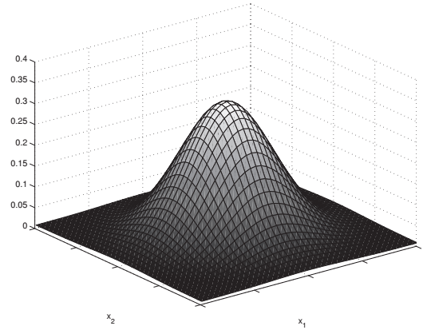
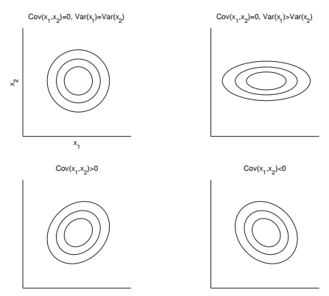
Example: Bivariate Normal Distribution
Bivariate case where d=2
For independent variables, major axis of the density is parallel to input axis

Slide 22
Bivariate Normal Distribution
For independent variables, the major axes of the density are parallel to the input axes.
Major axis: Longest diameter in ellipse
The density becomes an ellipse if the variances are different.
The density rotates depending on the sign of the covariance (correlation)
The center is given by mean and shape and orientation by covariance matrix

Slide 23
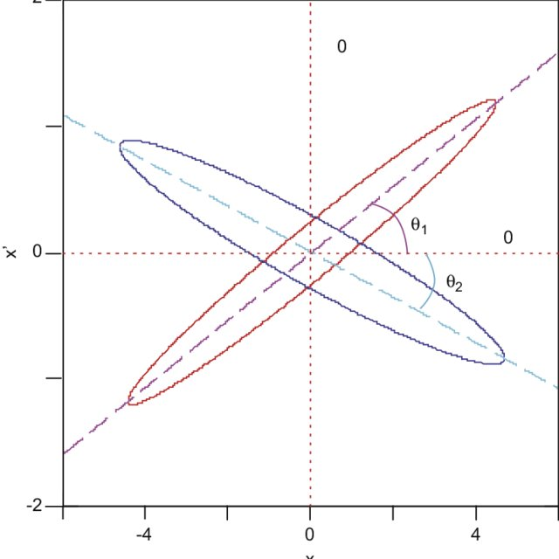
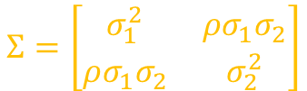




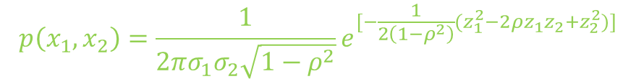
Joint Bivariate Normal Distribution
$$μ^{T}=[μ_{1},μ_{2}]$$
Mean vector:
Covariance Vector:
Joint bivariate density:
Z-normalization:
The process of making mean zero and unit standard deviation of input variables
Effect of value of correlation coefficient $ρ$:
$\left|ρ\right|<1$: $p\left(x_{1},x_{2}\right)$is the equation of ellipses
$ρ>1:$major axis of ellipses has positive slope (red ellipse)
$ρ<1:$major axis of ellipses has negative slope (blue ellipse)
$$Σ=\left[\begin{matrix}σ_{1}^{2} & ρσ_{1}σ_{2} \\ ρσ_{1}σ_{2} & σ_{2}^{2}\end{matrix}\right]$$
$$p\left(x_{1},x_{2}\right)=\frac{1}{2πσ_{1}σ_{2}\sqrt{1−ρ^{2}}}e^{[−\frac{1}{2\left(1−ρ^{2}\right)}(z_{1}^{2}−2ρz_{1}z_{2}+z_{2}^{2})]}$$
$where z_{i}=\frac{x−μ_{i}}{σ_{i}}$ where $i=1,2$
$$\left(z_{1}^{2}−2ρz_{1}z_{2}+z_{2}^{2}\right)=c$$

Slide 24
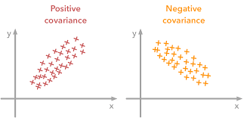

Joint Bivariate Normal Density
Each variable is normalized to have unit variance,
There is the cross-term that corrects for the correlation between the two variables.
There are five parameters in this case
$μ_{1},μ_{2},σ_{1},σ_{2},ρ$
Σ is nonsingular, and hence positive definite provided that variances are nonzero and |ρ| < 1
If ρ is +1 or -1, the two variables are linearly related, the observations are effectively one dimensional, and one of the two variables can be disposed of
If ρ = 0, then the two variables are independent, the cross-term disappears, and we get a product of two univariate densities

Slide 25

Univariate Interpretations
In univariate case small value of $σ^{2}$ indicates that samples are close to $μ$
$Var(X) >0$
Multivariate interpretations
In multivariate case small value of $\left|Σ\right|$ indicates that samples are close $μ$ where $μ=\{μ_{1},μ_{2}….,μ_{N}\}$
Σ is a symmetric positive definite matrix
Small |Σ| may also indicate that there is high correlation between variables
If $x ∼ N_{d}(μ, Σ),$then each dimension of $x$ is univariate normal
However, if each $X_{i}$ may be univariate normal and $X$ may not be multivariate normal

Slide 26
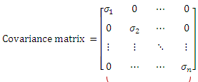

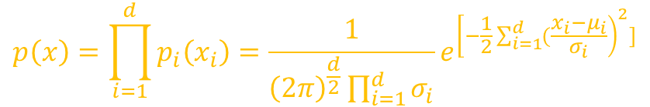
Naïve case of multivariate normal
If the components of $x$ are independent and $Cov(X_{i}, X_{j})=0$, for $i = j$, and $Var(Xi) = σ_{i}^{2}, ∀i$
Then the covariance matrix is diagonal and the joint density is the product of the individual univariate densities:
$$p\left(x\right)=\prod_{i=1}^{d}{p_{i}\left(x_{i}\right)=\frac{1}{{\left(2π\right)}^{\frac{d}{2}}\prod_{i=1}^{d}{σ_{i}}}e^{{\left[−\frac{1}{2}\sum_{i=1}^{d}{(\frac{x_{i}−μ_{i}}{σ_{i}}}\right)}^{2}]}}$$

Slide 27

Let $x ∼ N_{d}(μ, Σ)$ and $wεℜ^{d}$ then
$w^{T}x=w_{1}x_{1}+w_{2}x_{2}+…+w_{d}x_{d}$ $∼N(w^{T}μ, w^{T}Σw)$ given that
$E\left[w^{T}x\right]=w^{T}E\left[x\right]=w^{T}μ$
$Var\left(w^{T}x\right)=E\left[{\left(w^{T}x−w^{T}μ\right)}^{2}\right]=E\left[{\left(w^{T}x−w^{T}μ\right)}^{.}\left(w^{T}x−w^{T}μ\right)\right]$
$=E\left[{\left(w^{T}(x−μ\right)}^{.}{\left(x−μ\right)}^{T}w\right]$
$=w^{T}Σw$
the projection of a d-dimensional normal on the vector w is univariate normal
In general, if $W$ is a $d×k$matrix with rank $k<d$, then the $k$-dimensional $W^{T} x$ is $k$-variate normal:
$W^{T}x ∼ N_{k}(W^{T}μ, W^{T}ΣW)$
if we project a d-dimensional normal distribution to a space that is k-dimensional, then it projects to a k-dimensional normal

Slide 28
Exercise
Take the univariate dataset and find mean and standard deviation of it
Take a multi-variate dataset and find its mean and covariance matrix for it

Slide 29



Thanks for watching
Dr. Sajid Iqbal
Assistant Professor
Department of Computer Science
Bahauddin Zakariya University, Multan
sajidiqbal.pk@gmail.com
https://github.com/sajjo79/Design_and_Analysis_of_Algorithms
Allah Hafiz
COMEDXD

Slide 30
Assignments

